Slide 1

Md. Rahat Rawsan ID: 213100030

Slide 2

All About Qatar
Qatar is a great state in Western Asia, occupying a peninsula juts into the Arabian Gulf. One can't close his/her eyes when visiting Arab countries. She is pretty and compelling.
The excitement multiplies as Qatar is the official host of the 22nd FIFA World Cup. A month-long competition cum festival will be conducted in eight beautifully crafted stadiums across Qatar from November 21 to December 18, 2022.
22
Editions
08
Stadiums
65
Matches

Slide 3
FIFA World Cup - History
The first ever FIFA World Cup goes back to 1930. Jules Rimet, the President of FIFA (Fédération International de Football Association), the world's football governing body, decided to stage an international men's football tournament. The 1930s FIFA World Cup edition consisted of only thirteen teams invited by the organization. The entire world loves FIFA World Cup, which fetched successive responses and format remodeling every year. Its current 32-team final tournament is preceded by a two-year qualifying process involving around 200 teams worldwide.

Slide 4


World Cup Winners So Far
1930
Uruguay
1962
Brazil
1986
Argentina
2010
Spain
1934
Italy
1966
England
1990
Germany
2014
Germany
1938
Italy
1970
Brazil
1994
Brazil
2018
France
1950
Uruguay
1974
Germany
1998
France
2022
-?
1954
Germany
1978
Argentina
2002
Brazil
1958
Brazil
1982
Germany
2006
Italy

Slide 5
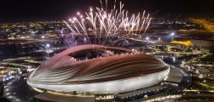
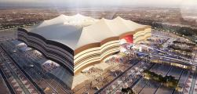
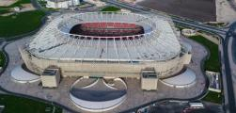
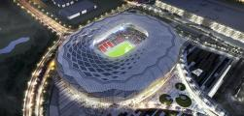
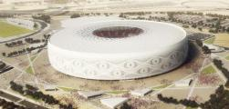
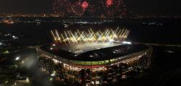
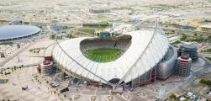
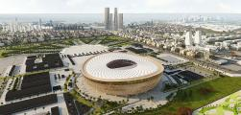
Playing Stadiums
Al Bayt Stadium
Al Bayt Stadium
Al Bayt Stadium
Al Bayt Stadium
Al Bayt Stadium
Al Bayt Stadium
Al Bayt Stadium
Al Bayt Stadium

Slide 6
Stadium In Qatar
01
-
Al Bayt Stadium
02
-
Lusail Stadium
03
-
Ahmad Bin Ali Stadium
01
04
-
Education City Stadium
03
04
06
02
05
-
Khalifa International Stadium
05
07
06
-
Stadium 974
08
07
-
Al Thumama Stadium
08
-
Al Janoub Stadium

Slide 7
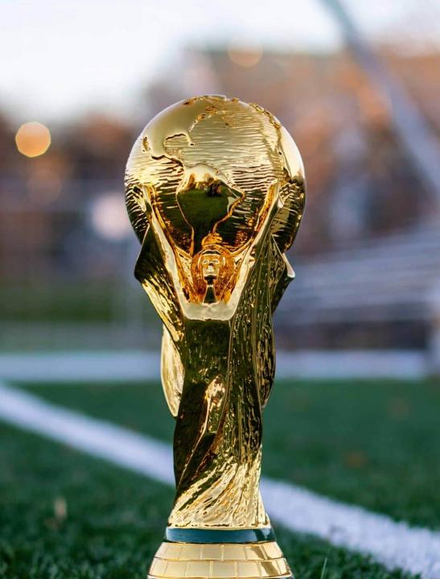
Meet La'eeb - Official Mascot
La'eeb is an Arabic word meaning super-skilled player. It's been chosen as the official mascot for FIFA World Cup 2022. La'eeb encourages everyone to believe in themselves as 'Now is All.'

Slide 8
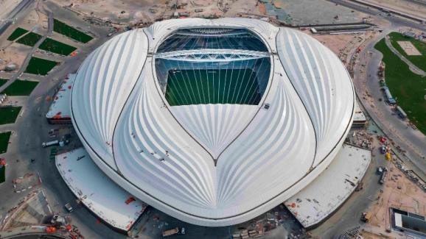
Official Anthem Of FIFA World Cup 2022
Hayya Hayya - Better Together.
It was released in April 2022.
It is performed by Cardona, Davido, and Aisha, while the video features images of Zinedine Zidane, Cafu, Edinson Cavani, Cristiano Ronaldo, and other football stars.

Slide 9
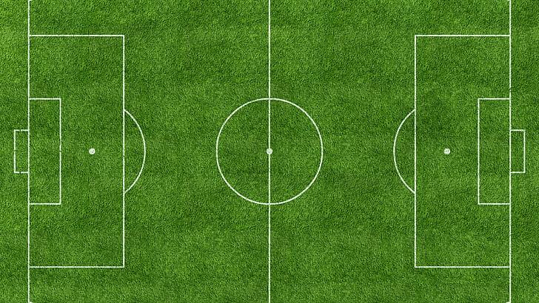

FIFA Official Ball
FIFA announces a unique match ball during every World Cup, which is named differently and has a special design and a color pattern. This year it is Al Riha. Take a look at the 360o full view of Al Riha.

Slide 10


32 Participating Teams of FIFA 2022
Group A
Group B
Group C
Group D
Qatar
England
Argentina
France
Ecuador
IR Iran
Saudi Arabia
Australia
Senegal
USA
Mexico
Denmark
Netherlands
Wales
Poland
Tunisia

Slide 11


32 Participating Teams of FIFA 2022
Group E
Group F
Group G
Group H
Spain
Belgium
Brazil
Portugal
Costa Rica
Canada
Serbia
Ghana
Germany
Morocco
Switzerland
Uruguay
Japan
Croatia
Cameroon
Korea Republic

Slide 12
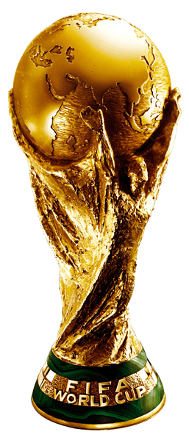
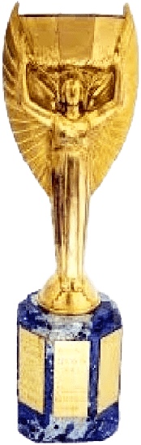
Evolution Of Trophy (1930-2022)
FIFA World Cup Trophy 1974-Present
Jules Rimet Trophy
1930-1970

Slide 13

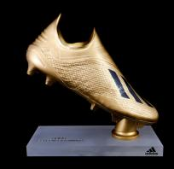

FIFA Awards
Golden Ball
Golden Boot
Golden Glove
Best Player
Top Goal Scorer
Best Goalkeeper

Slide 14

FIFA Quick Facts
First Tournament
Most Wins
Most Losses
1930 (Uruguay)
Brazil (5 times)
Mexico (8 times)
Most Appearances
Most Goals
Fastest Goal Scorer
Brazil (22 times)
Miroslav Klose (Germany)
Hakan Sukur (Turkey)

Slide 15
FIFA World Cup Fixtures
Arabia Standard Time (AST) UTC+03:00
01:00 pm
21 Nov 2022
04:00 pm
21 Nov 2022
Senegal
VS
Netherlands
England
VS
IR Iran
Monday
Al Thumama
Monday
Khalifa International
07:00 pm
21 Nov 2022
10:00 pm
21 Nov 2022
Qatar
VS
Ecuador
USA
VS
Wales
Monday
Al Bayt
Monday
Ahmad Bin Ali

Slide 16
Al Janoub Stadium
Arabia Standard Time (AST) UTC+03:00
10:00 pm
22 Nov 2022
01:00 pm
28 Nov 2022
France
VS
Australia
Cameroon
VS
Serbia
01:00 pm
24 Nov 2022
06:00 pm
30 Nov 2022
Switzerland
VS
Cameroon
Australia
VS
Denmark
01:00 pm
26 Nov 2022
06:00 pm
02 Dec 2022
Tunisia
VS
Australia
Ghana
VS
Uruguay

Slide 17
Al Bayt Stadium
Arabia Standard Time (AST) UTC+03:00
07:00 pm
21 Nov 2022
10:00 pm
27 Nov 2022
Qatar
VS
Ecuador
Spain
VS
Germany
01:00 pm
23 Nov 2022
06:00 pm
29 Nov 2022
Morocco
VS
Croatia
Netherlands
VS
Qatar
10:00 pm
25 Nov 2022
01:00 pm
01 Dec 2022
England
VS
USA
Costa Rica
VS
Germany

Slide 18
Ahmad Bin Ali Stadium
Arabia Standard Time (AST) UTC+03:00
10:00 pm
21 Nov 2022
01:00 pm
27 Nov 2022
USA
VS
Wales
Japan
VS
Costa Rica
10:00 pm
23 Nov 2022
10:00 pm
29 Nov 2022
Belgium
VS
Canada
Wales
VS
England
01:00 pm
25 Nov 2022
06:00 pm
01 Dec 2022
Wales
VS
IR Iran
Croatia
VS
Belgium

Slide 19
Education City Stadium
Arabia Standard Time (AST) UTC+03:00
04:00 pm
22 Nov 2022
04:00 pm
28 Nov 2022
Denmark
VS
Tunisia
Korea Republic
VS
Ghana
04:00 pm
24 Nov 2022
06:00 pm
30 Nov 2022
Uruguay
VS
Korea Republic
Tunisia
VS
France
04:00 pm
26 Nov 2022
06:00 pm
02 Dec 2022
Poland
VS
Saudi Arabia
Korea Republic
VS
Portugal

Slide 20
Al Thumama Stadium
Arabia Standard Time (AST) UTC+03:00
01:00 pm
21 Nov 2022
04:00 pm
27 Nov 2022
Senegal
VS
Netherlands
Belgium
VS
Morocco
07:00 pm
23 Nov 2022
10:00 pm
29 Nov 2022
Spain
VS
Costa Rica
IR Iran
VS
USA
04:00 pm
25 Nov 2022
06:00 pm
01 Dec 2022
Qatar
VS
Senegal
Canada
VS
Morocco

Slide 21
Stadium 974
Arabia Standard Time (AST) UTC+03:00
07:00 pm
22 Nov 2022
07:00 pm
28 Nov 2022
Mexico
VS
Poland
Brazil
VS
Switzerland
07:00 pm
24 Nov 2022
10:00 pm
30 Nov 2022
Portugal
VS
Ghana
Poland
VS
Argentina
07:00 pm
26 Nov 2022
10:00 pm
02 Dec 2022
France
VS
Denmark
Serbia
VS
Switzerland

Slide 22
Khalifa International Stadium
Arabia Standard Time (AST) UTC+03:00
04:00 pm
21 Nov 2022
07:00 pm
27 Nov 2022
England
VS
IR Iran
Croatia
VS
Canada
04:00 pm
23 Nov 2022
07:00 pm
29 Nov 2022
Germany
VS
Japan
Ecuador
VS
Senegal
07:00 pm
25 Nov 2022
10:00 pm
01 Dec 2022
Netherlands
VS
Ecuador
Japan
VS
Spain

Slide 23
Lusail Stadium
Arabia Standard Time (AST) UTC+03:00
01:00 pm
22 Nov 2022
10:00 pm
28 Nov 2022
Argentina
VS
Saudi Arabia
Portugal
VS
Uruguay
10:00 pm
24 Nov 2022
10:00 pm
30 Nov 2022
Brazil
VS
Serbia
Saudi Arabia
VS
Mexico
10:00 pm
26 Nov 2022
10:00 pm
02 Dec 2022
Argentina
VS
Mexico
Cameroon
VS
Brazil

Slide 24
To The Finals…
03 Dec
Saturday
04 Dec
Sunday
05 Dec
Monday
06 Dec
Tuesday
09 Dec
Friday
10 Dec
Saturday
13 Dec
Tuesday
14 Dec
Wednesday
17 Dec
Saturday
18 Dec
Sunday
Al Bayt
Stadium
1B vs 2A
W51 vs W52
W59 vs W60
22:00
22:00
22:00
Khalifa International
Stadium
1A vs 2B
3rd Place
18:00
18:00
Al Thumama Stadium
1D vs 2C
W55 vs W56
18:00
18:00
Ahmad Bin Ali Stadium
1C vs 2D
Round 16
Quarter Finals
Semi Finals
3rd Place & Final
22:00
Lusail Stadium
1H vs 2G
W49 vs W50
W57 vs W58
Final
22:00
22:00
22:00
18:00
Stadium 974
1G vs 2H
22:00
Education City Stadium
1F vs 2E
W53 vs W54
18:00
18:00
Al Janoub Stadium
1E vs 2F
18:00

Slide 25
Group Matches
21 Nov
Monday
22 Nov
Tuesday
23 Nov
Wednesday
24 Nov
Thursday
25 Nov
Friday
26 Nov
Saturday
27 Nov
Sunday
28 Nov
Monday
29 Nov
Tuesday
30 Nov
Wednesday
01 Dec
Thursday
02 Dec
Friday
Al Bayt
Stadium
QAT vs ECU
MAR vs CRO
ENG vs USA
ESP vs GER
NED vs QAT
CRC vs GER
19:00
13:00
22:00
22:00
18:00
22:00
Khalifa International
Stadium
ENG vs IRN
GER vs JPN
NED vs ECU
CRO vs CAN
ECU vs SEN
JPN vs ESP
16:00
16:00
19:00
19:00
18:00
22:00
Al Thumama Stadium
SEN vs NED
ESP vs CRC
QAT vs SEN
BEL vs MAR
IRN vs USA
CAN vs MAR
13:00
19:00
16:00
16:00
22:00
18:00
Ahmad Bin Ali Stadium
USA vs WAL
BEL vs CAN
WAL vs IRN
JPN vs CRC
WAL vs ENG
CRO vs BEL
22:00
22:00
13:00
13:00
22:00
18:00
Lusail Stadium
ARG vs KSA
BRA vs SRB
ARG vs MEX
POR vs URU
KSA vs MEX
CMR vs BRA
13:00
22:00
22:00
22:00
22:00
22:00
Stadium 974
MEX vs POL
POR vs GHA
FRA vs DEN
BRA vs SUI
POL vs ARG
SRB vs SUI
19:00
19:00
19:00
19:00
22:00
22:00
Education City Stadium
DEN vs TUN
URU vs KOR
POL vs KSA
KOR vs GHA
TUN vs FRA
KOR vs POR
16:00
16:00
16:00
16:00
18:00
18:00
Al Janoub Stadium
FRA vs AUS
SUI vs CMR
TUN vs AUS
CMR vs SRB
AUS vs DEN
GHA vs URU
22:00
13:00
13:00
13:00
18:00
18:00

Slide 26
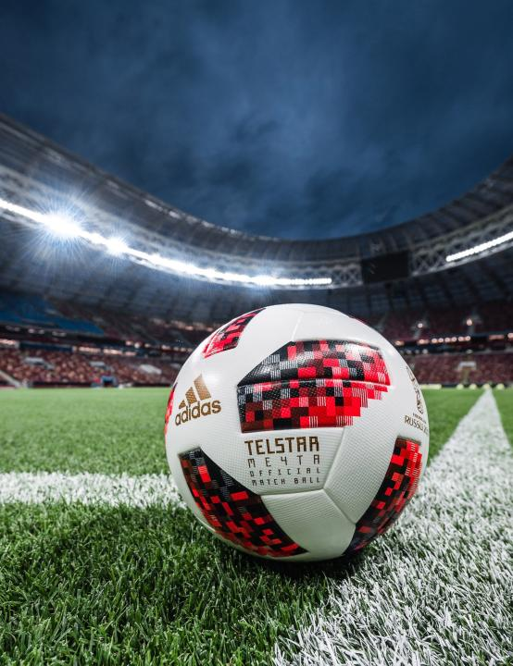
FIFA Official Partners
Federation Internationale de Football Association
Organising Committee for FIFA Competitions
FIFA World Cup Qatar 2022 LLC

Slide 27
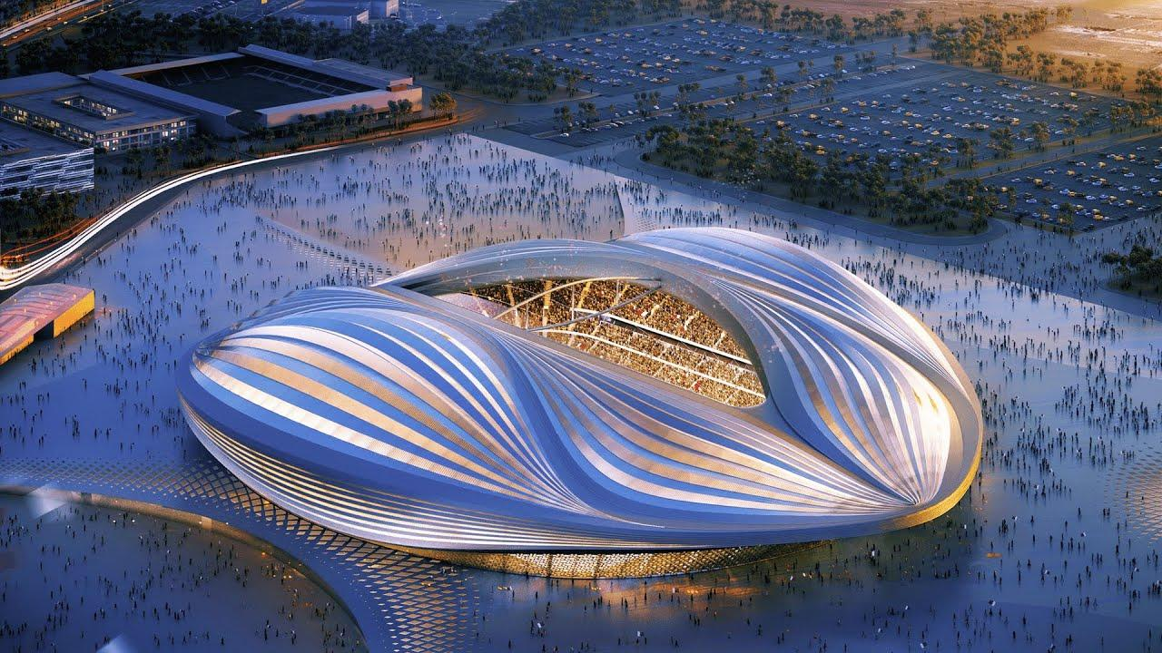








FIFA Official Partners

Slide 28




Thank You!
Rahat Rawsan Akhand

